Slide 1


Lesson 18-Delivering

Slide 2

Overview
Testing.
Prerequisites for delivering a product.
Delivering on CD-ROM.
Packaging.
Delivering on the World Wide Web.

Slide 3
Testing
It is important to test and review a project to ensure that:
  It is bug-free, accurate, and operationally and visually on target.
  The client's requirements have been met.
  The reputation of the developer/company is not damaged by a premature or erroneous release.
  Cross-platform issues are addressed by comprehensive testing on different hardware and software platforms.

Slide 4
Testing
Difficulties in testing:
  The performance of a multimedia project depends on hardware and software configurations, and the end-user's connection speed.
  Few computer configurations are identical.
  The Macintosh environment is sensitive to certain extensions that conflict with some software applications.

Slide 5
Testing
Alpha testing.
Beta testing.
Final release.

Slide 6
Alpha Testing
An alpha release is the first working draft of a project.
An alpha release of a project is only for internal circulation.
Alpha testing is usually done “in-house” by team members.
Alpha releases are expected to have problems or to be incomplete.

Slide 7
Beta Testing
Beta testing is done with a wider array of testers.
Beta testers should be representative of real users.
These testers should be people who were not involved with the actual production.
Beta level bugs are typically less virulent than alpha bugs.
Managing beta test feedback is critical.

Slide 8
Final Release
The terms such as “bronze” or “release candidate” are used to identify products that are near completion.
The final release version is usually called the “gold master.”

Slide 9
Prerequisites for Delivering a Product
After a multimedia project is complete, modify the files so that they can be transferred from the media to the user’s platform.
A setup program is required to install a project on a user’s computer.
Programs like Mindvision's Installer Vise and Aladdin's InstallerMaker help create installers.

Slide 10
Prerequisites for Delivering a Product
It is important to provide well-written documentation about the installation process.
The documentation must also list potential problems, constraints, and appropriate warning messages.

Slide 11
Prerequisites for Delivering a Product
It is useful to include a file, README.TXT or ReadMeFirst, on the distribution disc of a project.
The file should contain a detailed description of the installation process.

Slide 12
Prerequisites for Delivering a Product
The README.TXT document includes a description of changes or bugs reported since the documentation was printed.
Set up a product-related Web site with pages for registering software, reporting bugs, providing technical support, and program upgrades.

Slide 13
Prerequisites for Delivering a Product
Using compression programs.
Creating file archives.
Creating self-extracting archives.

Slide 14
Using Compression Programs
Use a shareware or commercial compression utility for compressing and decompressing files.
WinZip, DiscDoubler, and StuffIt Deluxe are commonly used compression utilities.
Most compression utilities also provide an encryption or security feature, which helps hide classified data.

Slide 15
Creating File Archives
One or more files of a project can be compressed into a single file, known as an archive.
Compressed files take less time to transmit than uncompressed files.
When an archive is decompressed, each individual file in the archive is reconstituted.
Archives are recognized by their file name extensions.

Slide 16
Creating Self-Extracting Archives
Self-extracting archives are used to deliver projects on discs in a compressed form.
Self-extracting files allow a user to run the executable archive.
The compressed files are automatically decompressed and placed on the hard disk.

Slide 17
Delivering on CD-ROM
Compact Disc Read Only Memory (CD-ROMs) are wafers of thin plastic and metal measuring 4.75” (120mm) in diameter. A laser reads pits in the disc that store data.
A CD may contain one or more tracks.
The primary logical unit for data storage on a CD is a sector.
A CD-ROM can hold more than 700 MB of data.

Slide 18
Delivering on CD-ROM
A majority of multimedia products are delivered on CD-ROMs.
Software that cannot be downloaded from the Internet is packaged on CD-ROMs.
It is an excellent and a cost-effective method of distributing multimedia projects.

Slide 19
Delivering on CD-ROM
Compact disc standards.
ISO 9660.
Hierarchical File System (HFS).
CD-ROM/Extended Architecture (CD-ROM/XA).
Various CD formats.

Slide 20
Compact Disc Standards
Philips and Sony introduced CD technology in 1979.
This collaboration resulted in the Red Book standard.
The “Red Book” defines the standard for audio CDs.

Slide 21
Compact Disc Standards
Various colors represent different types of CD-ROMs.
  The Yellow Book represents CD-ROM.
  The Green Book represents CD-I (Interactive).
  The Orange Book represents write-once, read-only (WORM) CD-ROMs.
  The White Book represents Video CD (Karaoke CD).

Slide 22
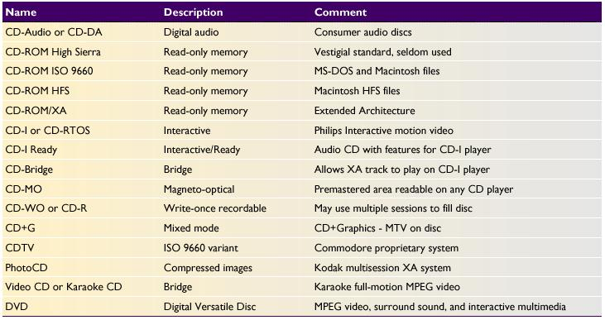
Compact Disc Standards
Compact Disc Formats

Slide 23
ISO 9660
The ISO 9660 standard is the most widely used digital data file format for CDs.
The file naming convention of the ISO 9660 is similar to MS-DOS.
Macintosh files and PC files can be saved on the same CD in a hybrid format. This allows users to launch applications for the appropriate platform.

Slide 24
Hierarchical File System (HFS)
HFS is a method developed by Apple for managing files and folders on the Macintosh desktop.
If a multimedia project needs to be delivered only on Macintosh platform, the HFS format is the preferred choice.
It does not comply with the ISO 9660 standard.

Slide 25
CD-ROM/Extended Architecture (CD-ROM/XA)
CD-ROM/XA is an extension of the Yellow Book standard.
It allows both computer data and compressed audio or video to play simultaneously.

Slide 26
Various CD Formats
PhotoCD format - This format is developed by Kodak, and can contain 125 or more high-resolution images.
Phillips CD-I - These disks are designed to play on a consumer-grade player connected to a television set. They contain Red Book audio as well as interactive video content.
Video CD or White Book - This standard was developed by Philips and Victor Company of Japan (JVC). These discs can play on most players using CD-ROM/XA.

Slide 27
Various CD Formats
DVDs provide 4.7 gigabytes of storage on a disc.
They employ a multilayer, high-density manufacturing process.

Slide 28
Packaging
When packaging a product, the following points must be considered:
    The art for the cover should reflect the content and function of the enclosed product.
    The company logo should be prominent.

Slide 29
Packaging
The name of the title should be featured on the front face and spine of the package.
Use shrink-wrap technique to avoid pilferage while shipping.
Use environment-friendly packaging for CDs.

Slide 30
Delivering on the World Wide Web
Involves transferring project files to a Web server.
User-owned delivery Web server provides better security control, better integration, and fine-tuning of server’s configuration parameters.

Slide 31
Delivering on the World Wide Web
A full-time Webmaster may be required.
If a project is to be hosted by an ISP, then find out the limitations of the service provider, and design the project within those limitations in mind.
Register the project with a search engine.

Slide 32
Summary
Testing ensures that a project is bug-free, accurate, and satisfies a client’s requirements.
Delivering the project on a CD-ROM is the most popular method among multimedia developers.
Multimedia can also be delivered on the World Wide Web by hosting the pages on a Web server.

